Slide 1
Linear Classifiers
Dept. Computer Science & Engineering,
Shanghai Jiao Tong University

Slide 2
Outline
Linear Regression
Linear and Quadratic Discriminant Functions
Reduced Rank Linear Discriminant Analysis
Logistic Regression
Separating Hyperplanes
Linear Classifiers

Slide 3

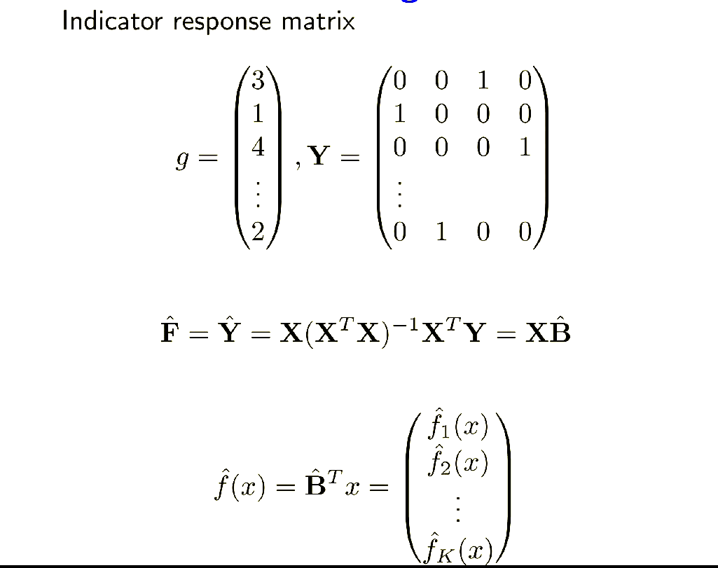
Linear Regression
Linear Classifiers

Slide 4
Linear Regression
The response classes is coded by a indicator variable. A K classes depend on K indicator variables, as Y(k), k=1,2,…, K, each indicate a class. And N train instances of the indicator vector could form a indicator response matrix Y.
To the Data set X(k), there is map:
X : X(k) Y(k)
According to the linear regression model:
f(x)=(1,X^{T})B^
Y ^=X(X^{T}X)⁻¹X^{T}Y
Linear Classifiers

Slide 5
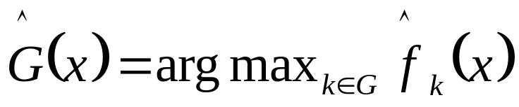
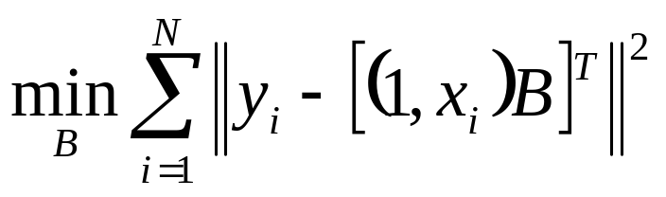
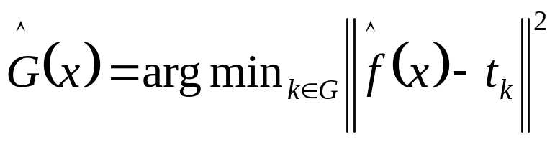
Linear Regression
Given X, the classification should be:
In another form, a target t_{k} is constructed for each class, the t_{k} presents the kth column of a K identity matrix, according to the a sum-of-squared-norm criterion :
and the classification is:
Linear Classifiers

Slide 6
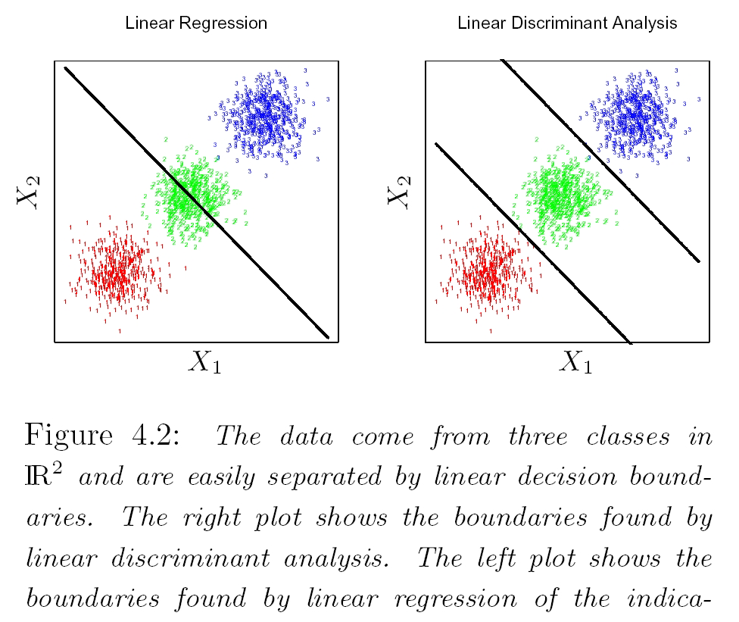
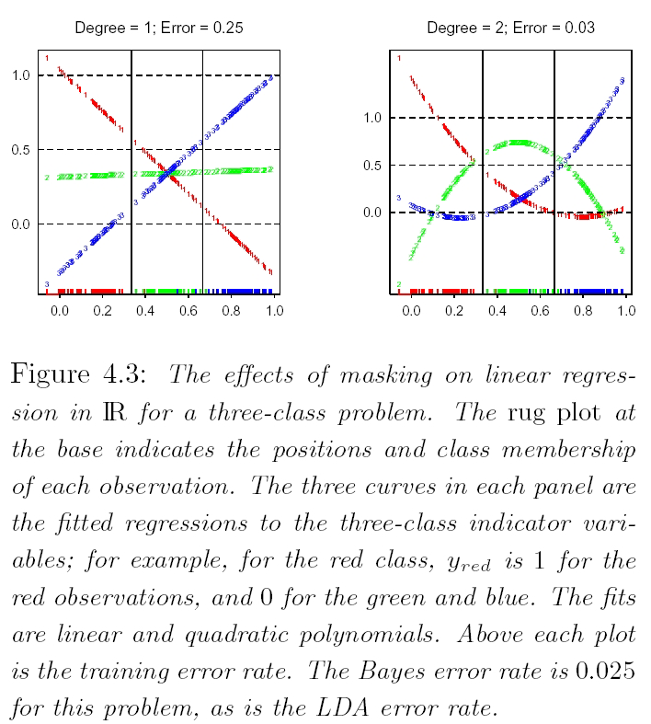
Problems of the linear regression
The data come from three classes in IR² and easily separated by linear decision boundaries.
The left plot shows the boundaries found by linear regression of indicator response variables.
The middle class is completely masked .
The rug plot at bottom indicates the positions and the class membership of each observations. The 3 curves are the fitted regressions to the 3-class indicator variables.
Linear Classifiers

Slide 7
Problems of the linear regression
The left plot shows the boundaries found by linear discriminant analysis. And the right shows the fitted regressions to the 3-class indicator variables.
Linear Classifiers

Slide 8
Outline
Linear Regression
Linear and Quadratic Discriminant Functions
Reduced Rank Linear Discriminant Analysis
Logistic Regression
Separating Hyperplanes
Linear Classifiers

Slide 9
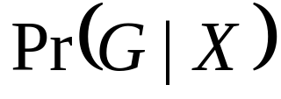
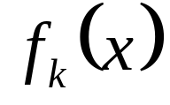
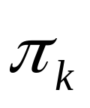
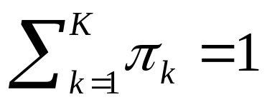
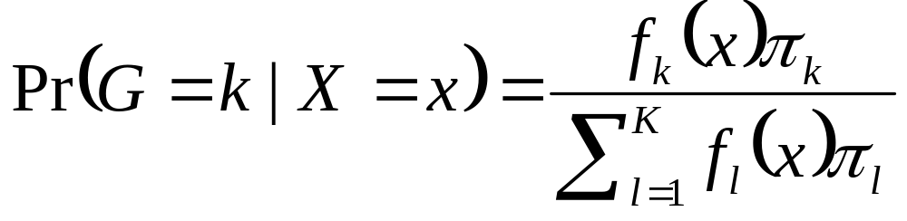
Linear Discriminant Analysis
According to the Bayes optimal classification mentioned in chapter 2, the posteriors is needed.
post probability :
assume:
——condition-density of X in class G=k.
——prior probability of class k, with
Bayes theorem give us the discriminant:
Linear Classifiers

Slide 10
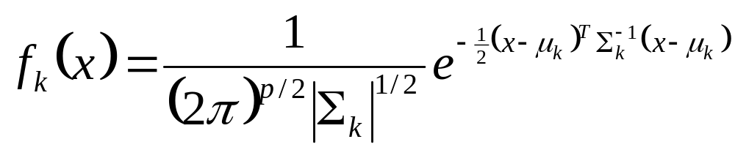
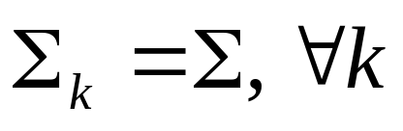
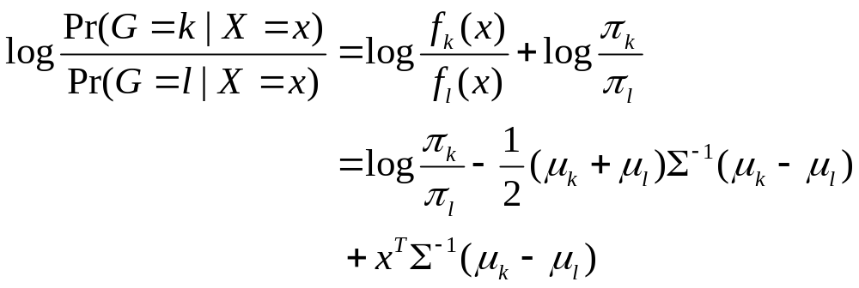
Linear Discriminant Analysis
Multivariate Gaussian density:
Comparing two classes k and l , assume
Linear Classifiers

Slide 11
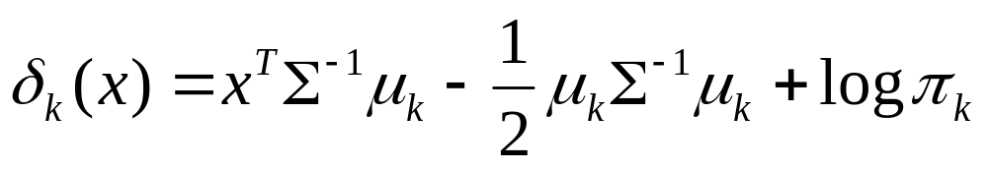
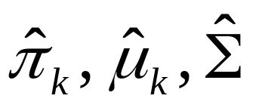
Linear Discriminant Analysis
The linear log-odds function above implies that the class k and l is linear in x; in p dimension a hyperplane.
Linear Discriminant Function:
So we estimate
Linear Classifiers

Slide 12
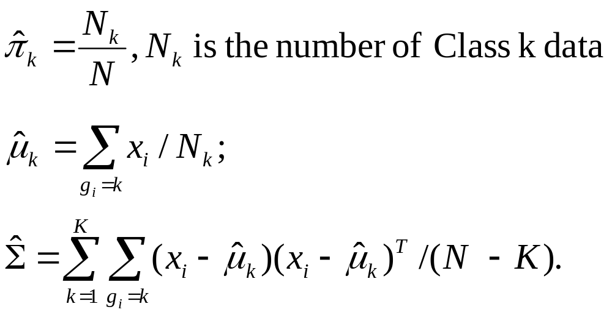
Parameter Estimation
Linear Classifiers

Slide 13
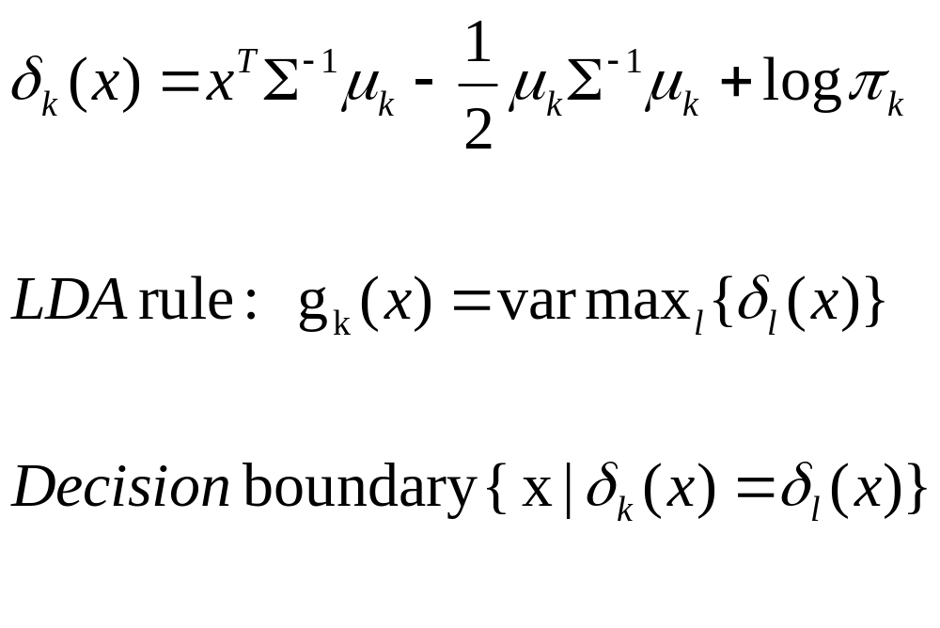
LDA Rule
Linear Classifiers

Slide 14
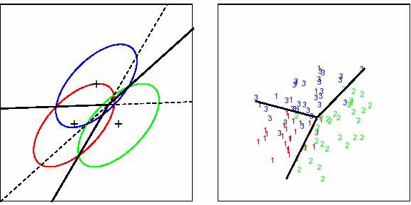
Linear Discriminant Analysis
Three Gaussian distribution with the same covariance and different means. The Bayes boundaries are shown on the left (solid lines). On the right is the fitted LDA boundaries on a sample of 30 drawn from each Gaussian distribution.
Linear Classifiers

Slide 15
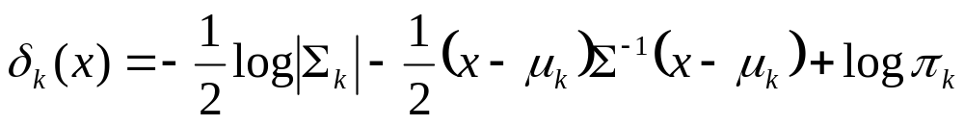
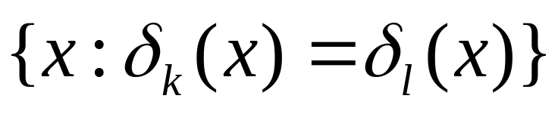
Quadratic Discriminant Analysis
When the covariance are different
This is the Quadratic Discriminant Function
The decision boundary is described by a quadratic equation
Linear Classifiers

Slide 16
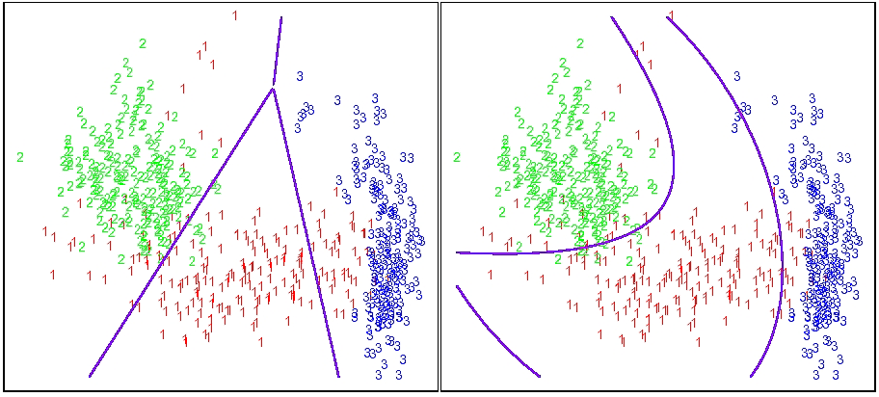
LDA & QDA
Boundaries on a 3-classes problem found by both the linear discriminant analysis in the original 2-dimensional space X₁, X₂ (the left) and in a 5-dimensional space X₁, X₂, X₁₂, X₁², X₂² (the right).
Linear Classifiers

Slide 17
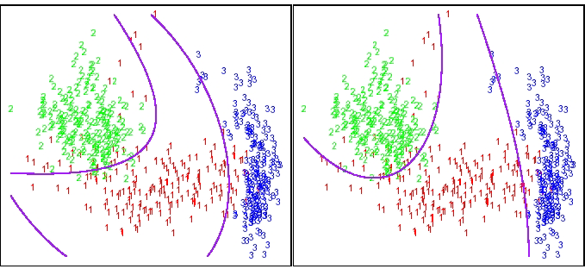
LDA & QDA
Boundaries on the 3-classes problem found by LDA in the 5-dimensional space above (the left) and by Quadratic Discriminant Analysis (the right).
Linear Classifiers

Slide 18
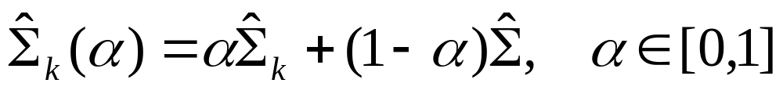

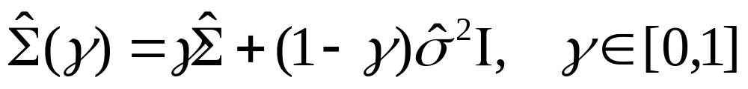
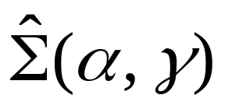
Regularized Discriminant Ana.
Shrink the separate covariances of QDA toward a common covariance as in LDA.
Regularized QDA
was allowed to be shrunk toward the scalar covariance.
Regularized LDA
Together :
Linear Classifiers

Slide 19
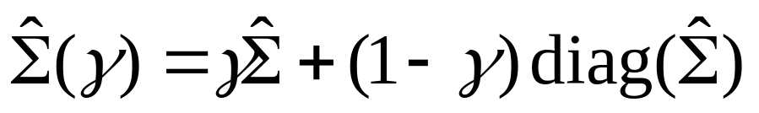
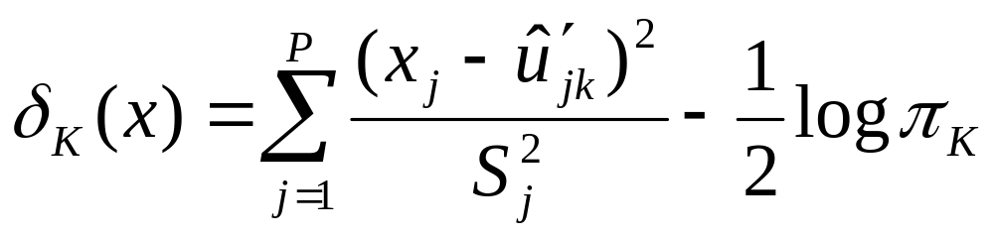
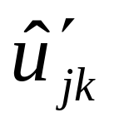
Regularized Discriminant Ana.
Could use
In recent micro expression work, we can use
where in a “SHRUNKEN CENTROID”
Linear Classifiers

Slide 20
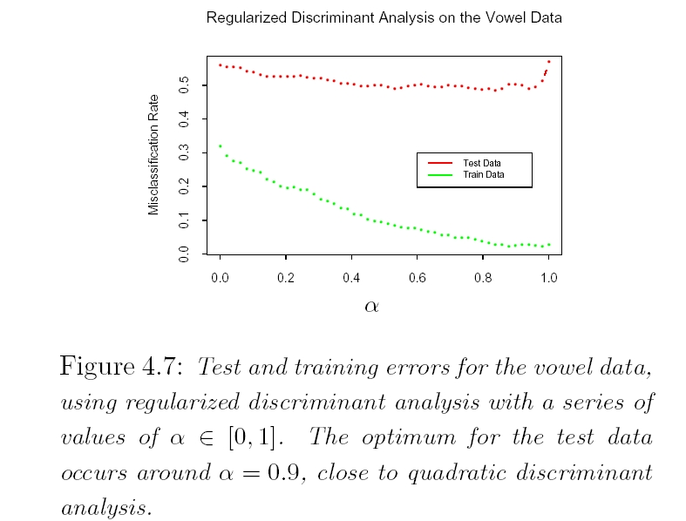


Test and training errors for the vowel data, using regularized discriminant analysis with a series of values of . The optimum for the test data occurs around , close to quadratic discriminant analysis
Linear Classifiers

Slide 21
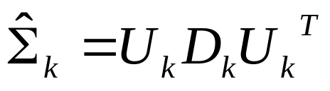



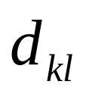
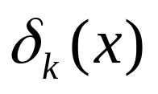
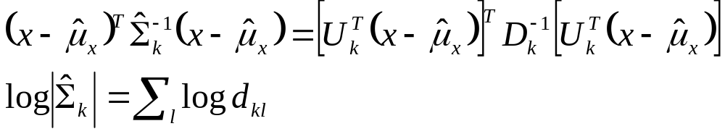
Computations for LDA
The eigen-decomposition for each
where is orthonormal, and is a diagonal matrix of positive eigenvalues .
So the ingredients for are:
Linear Classifiers

Slide 22
Outline
Linear Regression
Linear and Quadratic Discriminant Functions
Reduced Rank Linear Discriminant Analysis
Logistic Regression
Separating Hyperplanes
Linear Classifiers

Slide 23
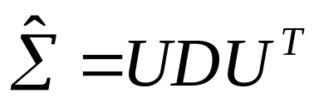
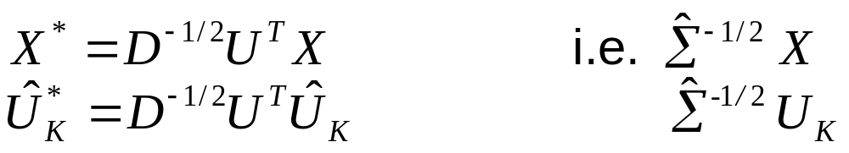
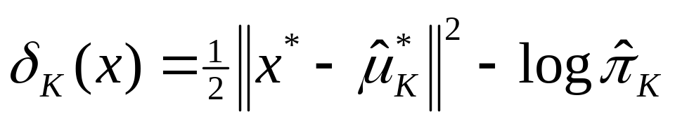

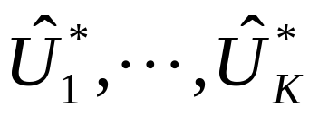

Reduced Rank LDA
Let
Let
LDA:
    Closest centroid in sphered space( apart from )
Can project data onto K-1 dim subspace spanned by , and lose nothing!
Can project even lower dim using principal components of , k=1, …, K.
Linear Classifiers

Slide 24
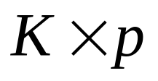
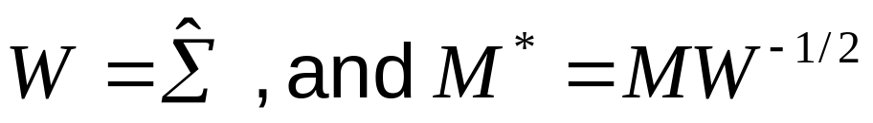
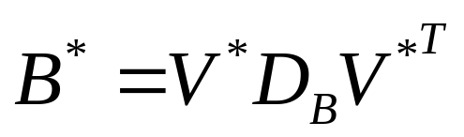
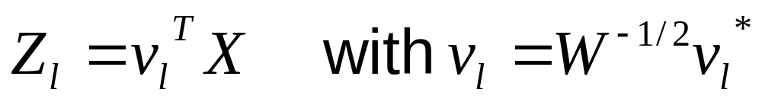
Reduced Rank LDA
Compute matrix M of centroids
Compute
Compute B*, cov matrix of M* , and
is l-th discriminant variable ( canonical variable )
Linear Classifiers

Slide 25
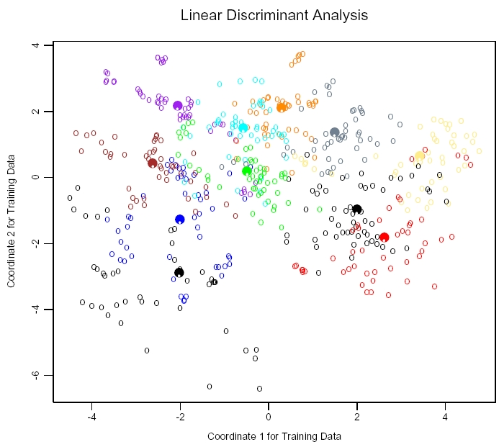

A two-dimensional plot of the vowel training data. There are eleven classes with ,and this is the best view in terms of a LDA model. The heavy circles are the projected mean vectors for each class.
Linear Classifiers

Slide 26
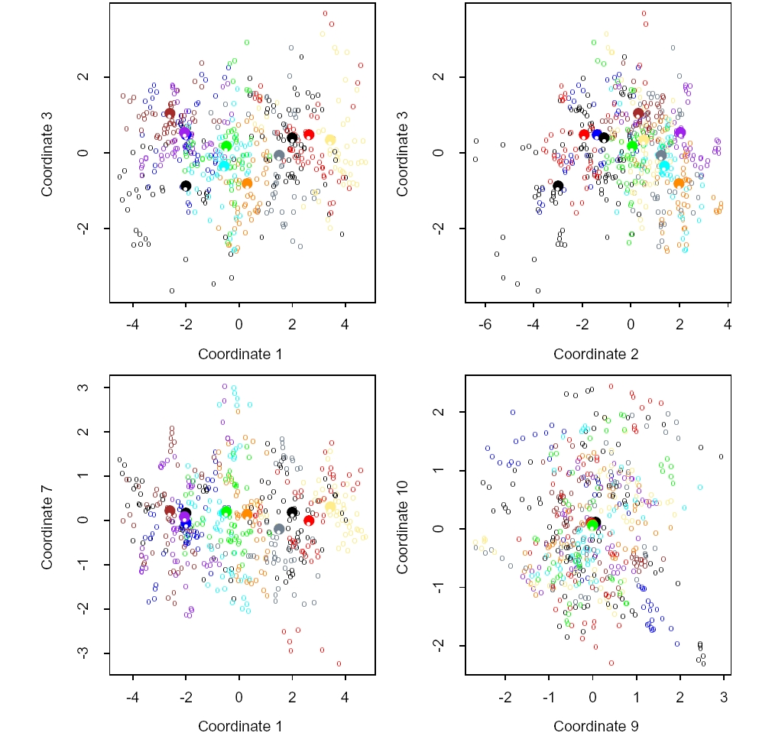
Projections onto different pairs of canonical varieties
Linear Classifiers

Slide 27
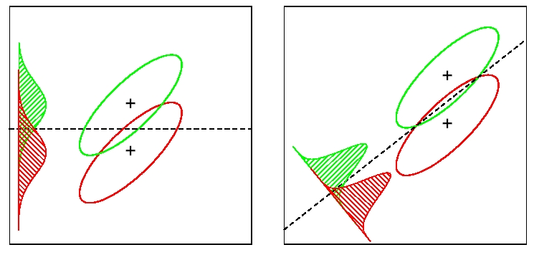
Reduced Rank LDA
Although the line joining the centroids defines the direction of greatest centroid spread, the projected data overlap because of the covariance ( left panel).
The discriminant direction minimizes this overlap for Gaussian data ( right panel).
Linear Classifiers

Slide 28
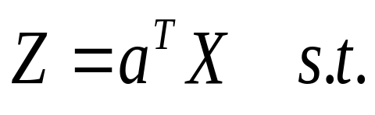
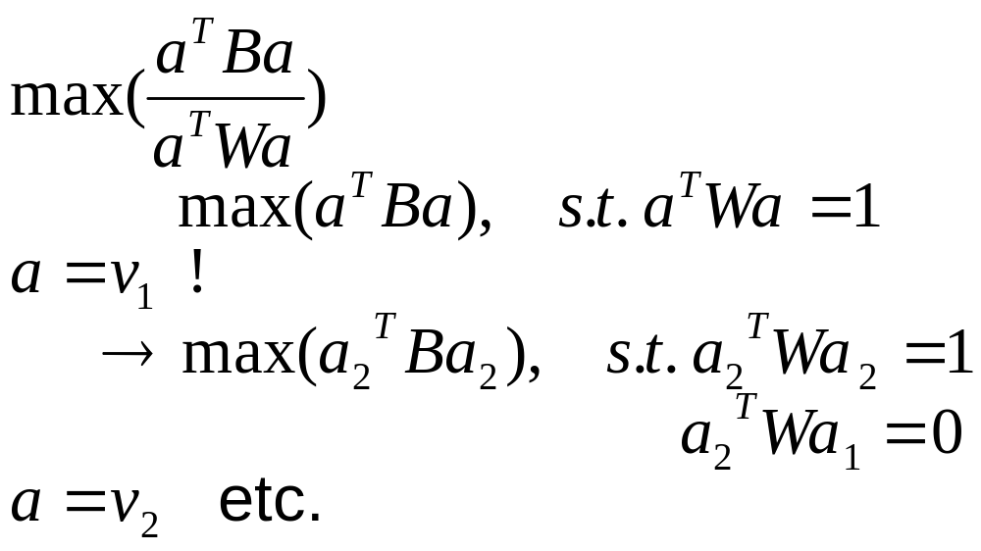
Fisher’s problem
Find “between-class var” is maximized relative to “within-class var”.
Maximize “Rayleigh quotient” :
Linear Classifiers

Slide 29
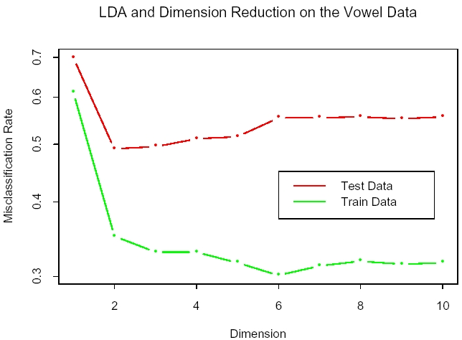
Training and test error rates for the vowel data, as a function of the dimension of the discriminant subspace.
In this case the best rate is for dimension 2.
Linear Classifiers

Slide 30
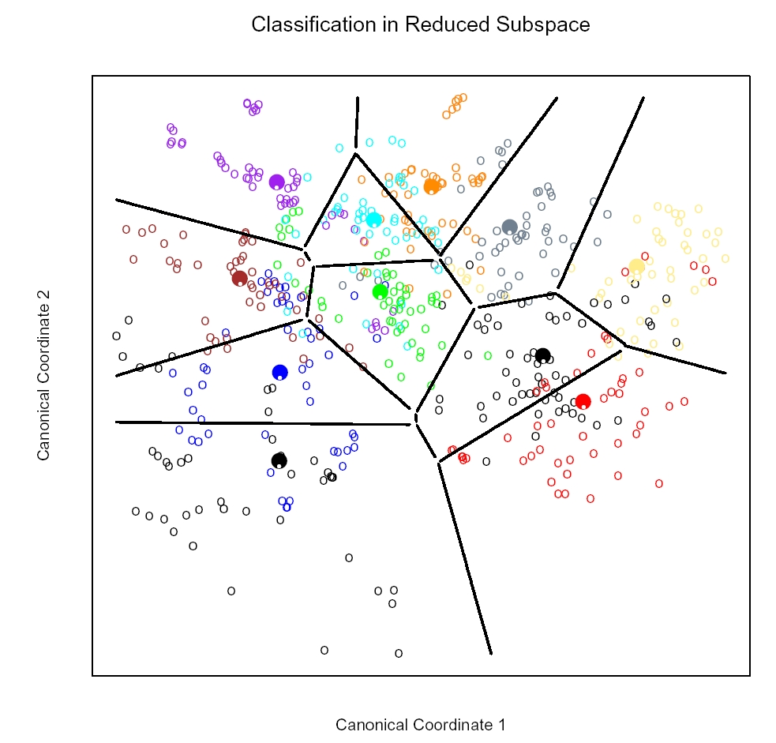
Linear Classifiers

Slide 31
Outline
Linear Regression
Linear and Quadratic Discriminant Functions
Reduced Rank Linear Discriminant Analysis
Logistic Regression
Separating Hyperplanes
Linear Classifiers

Slide 32
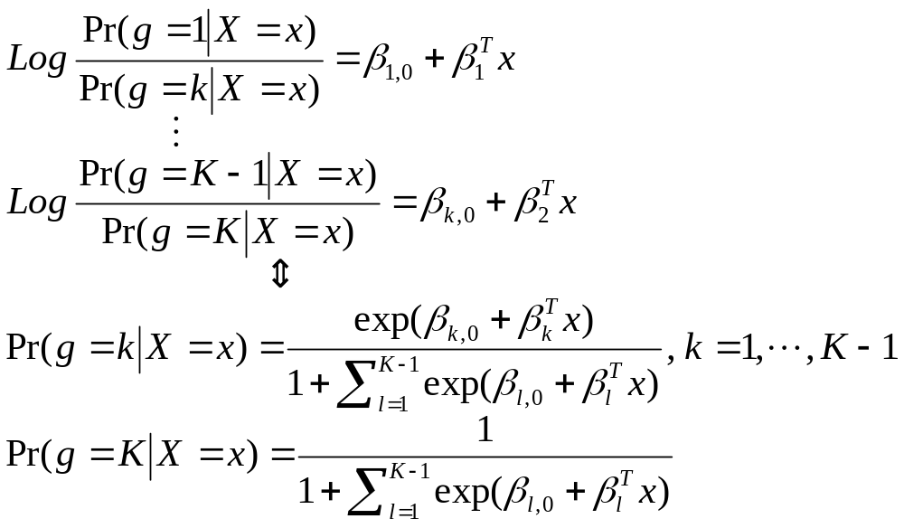

Logistic Regression
Model:
Linear Classifiers

Slide 33

South African Heart Disease Data ldl=low density lipoprotein sbp=Systolic blood pressure
Linear Classifiers

Slide 34

Linear Classifiers

Slide 35


Logistic Regression / LDA
Same form as Logistic Regression
Conditional Likelihood
Probability
Linear Classifiers

Slide 36


L1 Regularized Logistic Regression
Linear Classifiers

Slide 37
Outline
Linear Regression
Linear and Quadratic Discriminant Functions
Reduced Rank Linear Discriminant Analysis
Logistic Regression
Separating Hyperplanes
  Problem: Is there an optimal classifier?
Linear Classifiers

Slide 38



Rosenblatt’s Perceptron Learning Algorithm
--distance of points in M to boundary
Stochastic Gradient Descent
Linear Classifiers

Slide 39

Separating Hyperplanes
A toy example with two classes separable by hyperplane. The orange line is the least squares solution, which misclassifies one of the training points. Also shown are two blue separating hyperplanes found by the perceptron learning algorithm with different random starts.
Linear Classifiers

Slide 40



Optimal Separating Hyperplanes
Linear Classifiers

Slide 41
http://www-stat.stanford.edu/~tibs/ElemStatLearn/
Linear Classifiers

